Slide 1
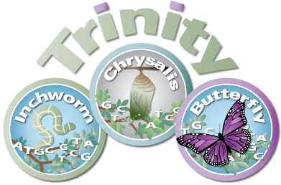
Intro to Transcriptomics and Transcriptome Assembly Programming for Biologists CSHL 2025
Brian Haas, Ph.D. Principal Computational Scientist Broad Institute

Slide 2
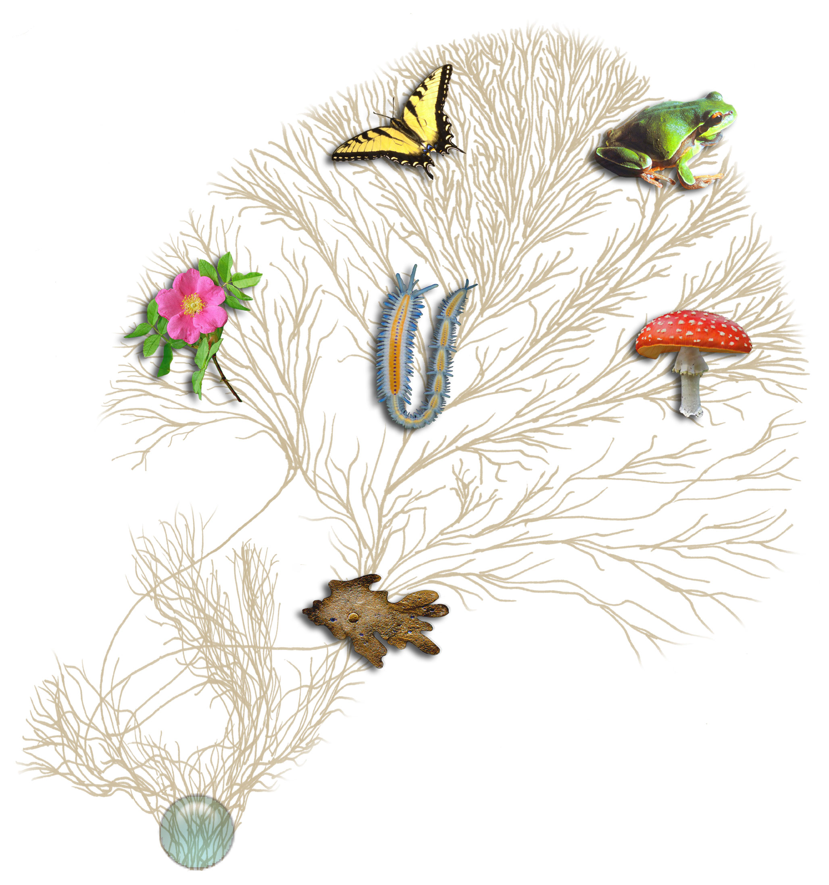
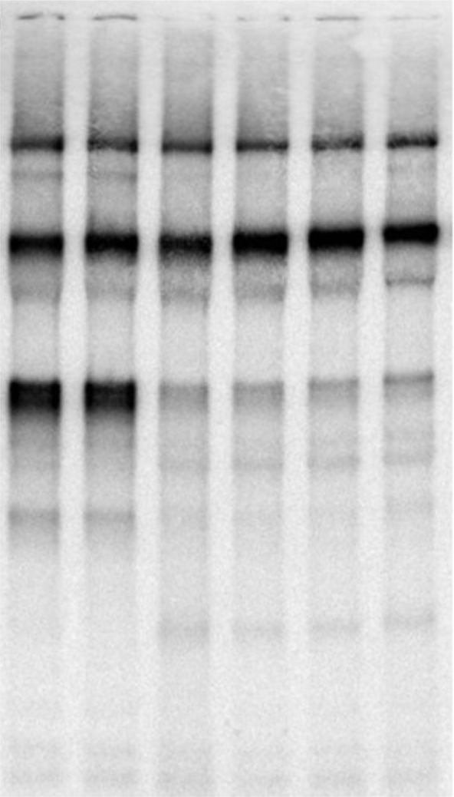
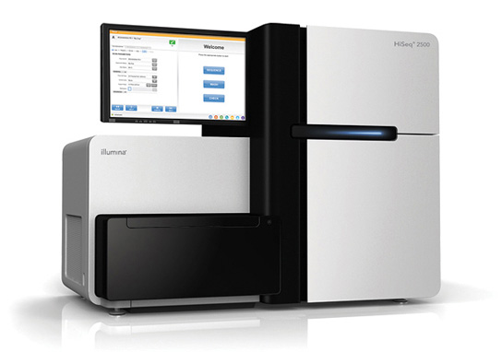
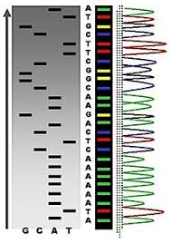
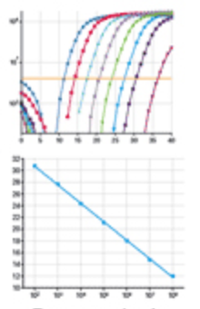
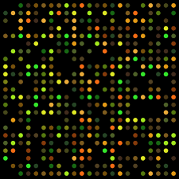
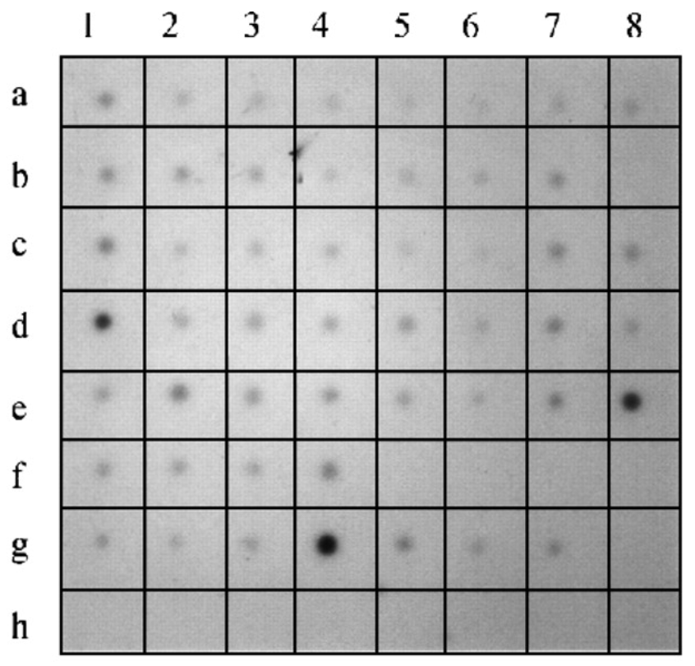
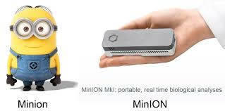
Biological Investigations Empowered by Transcriptomics
Extract RNA,
… some protocol for processing, ...
Northern
Analysis Method
(pick your favorite)
Other…
Microarray
Dot Blot
Sanger Sequencing
qRT-PCR
Notes:
Many biological investigations have been empowered by transcriptomics over the years.
Transcriptomics has historically involved extracting RNA from some living organism and then using some technology to study its various characteristics, such as quantifying expression or identifying its sequence
And the technology has changed dramatically over the years, from doing Northern blots with radioactive isotopes to microarrays, qRT-PCR, and the various advances in sequencing.

Slide 3
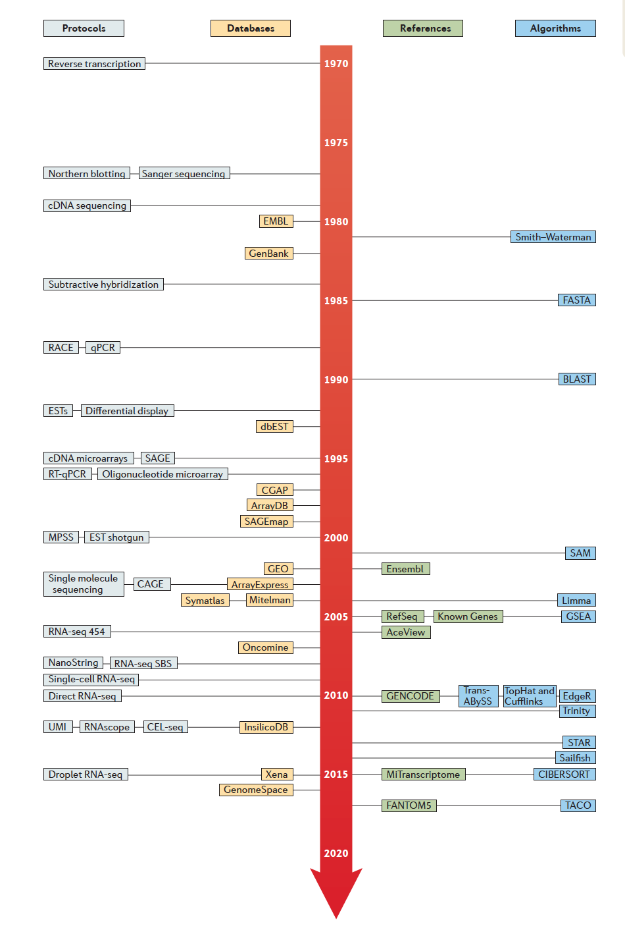
Historical Timeline to Modern Transcriptomics (from 1970)
Reverse Transcription (1970)
Note: Just a small sampling of what’s available.
Northern Blot
Sanger Sequencing
(1977)
Smith Waterman (1981)
BLAST (1990)
Expressed Sequence Tags (1992)
cDNA microarrays (1995)
Tophat/Cufflinks (2010)
RNA-Seq (2006-2008)
RSEM
(2011)
PacBio IsoSeq (2014)
Droplet single cell RNA-Seq (2015)
Direct RNA Seq Nanopore (2018)
Kallisto (2016)
Salmon (2017)
From Cieslik and Chinnaiyan,
NRG, 2017
Lots more!
Notes:
Advances in transcriptomics spanned developments in experimental protocols, sequence databases, and algorithms for analyzing these data, as shown in this timeline from a recent review paper in Nature Reviews Genetics.
I pulled out a few notable examples so you could better read them, and added a few of my own.
The discovery of reverse transcriptase in 1970 arguably kicked off most of the modern advancements. Almost all RNA methods commonly used today leverage reverse transcriptase as part of the protocol.
Some key developments involved EST sequencing in the early 1990’s, which led to the development of cDNA microarrays. It wasn’t until about 10 years later that massively parallel sequencing of RNAs was made possibly by innovations in next generation sequencing technologies.
Just a couple of years ago, droplet-based single cell rna-sequencing was developed, and less than 48 hours ago, Nature published a paper on direct sequencing of RNA via nanopore sequencings.
It’s a very exciting field and area of research, and it’s tightly coupled to advances in software tools for processing and analyzing these data.

Slide 4
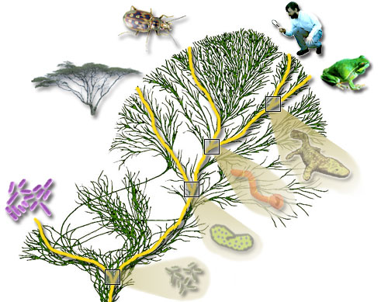
Modern Transcriptome Studies Empowered by RNA-seq
Extract RNA, convert to cDNA
Next-gen Sequencer
(pick your favorite)
Millions to Billions of Reads
Notes:
Modern transcriptome studies are termed RNA-Seq

Slide 5
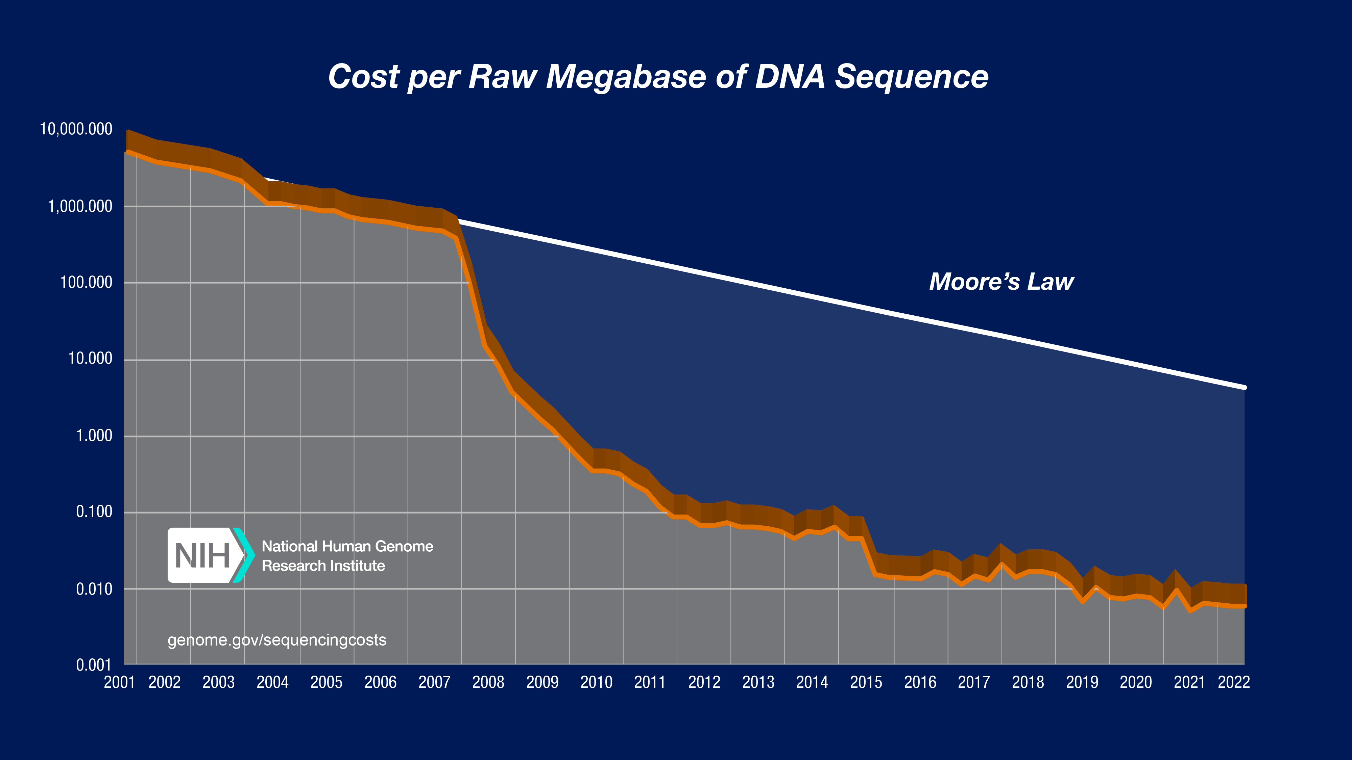
From https://www.genome.gov/sequencingcostsdata/
Notes:
We’ve witnessed a technological revolution.
Routinely sequencing as an assay for biological discovery.

Slide 6
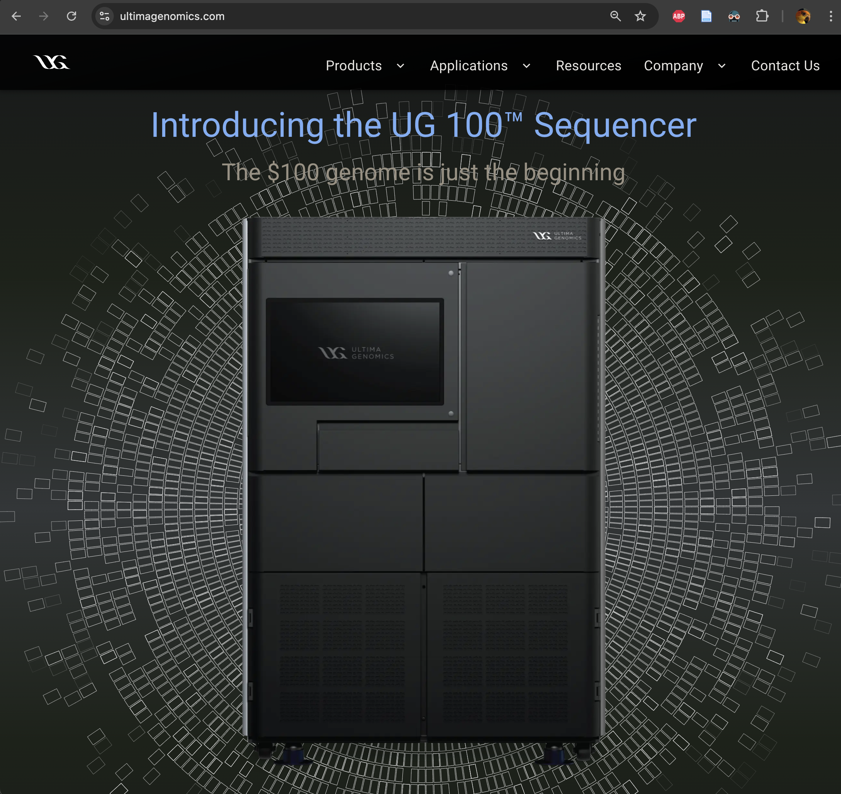
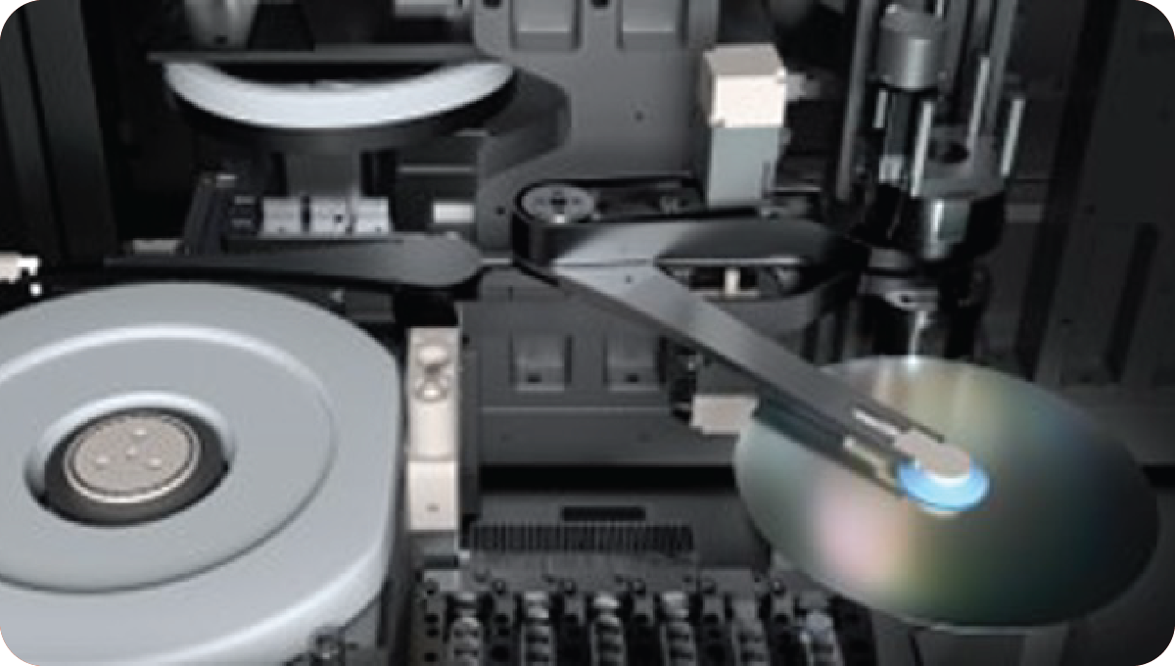
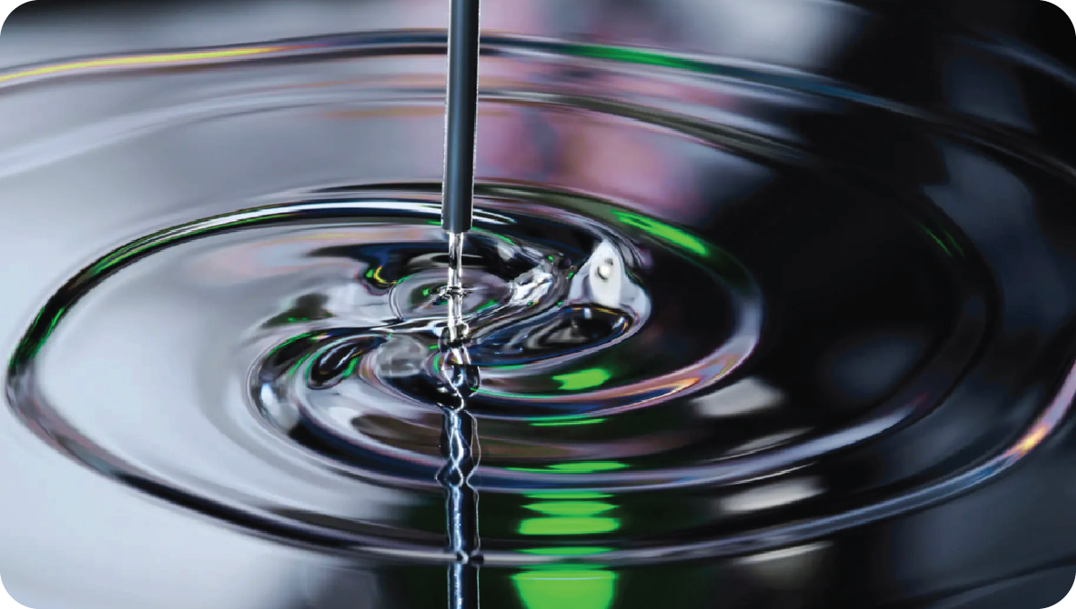
Ultima Genomics – high throughput, low cost genomics at scale
(Unveiled mid-2022)
The UG 100 sequencer can read up to 20,000 human genomes per year for $100 per genome

Slide 7
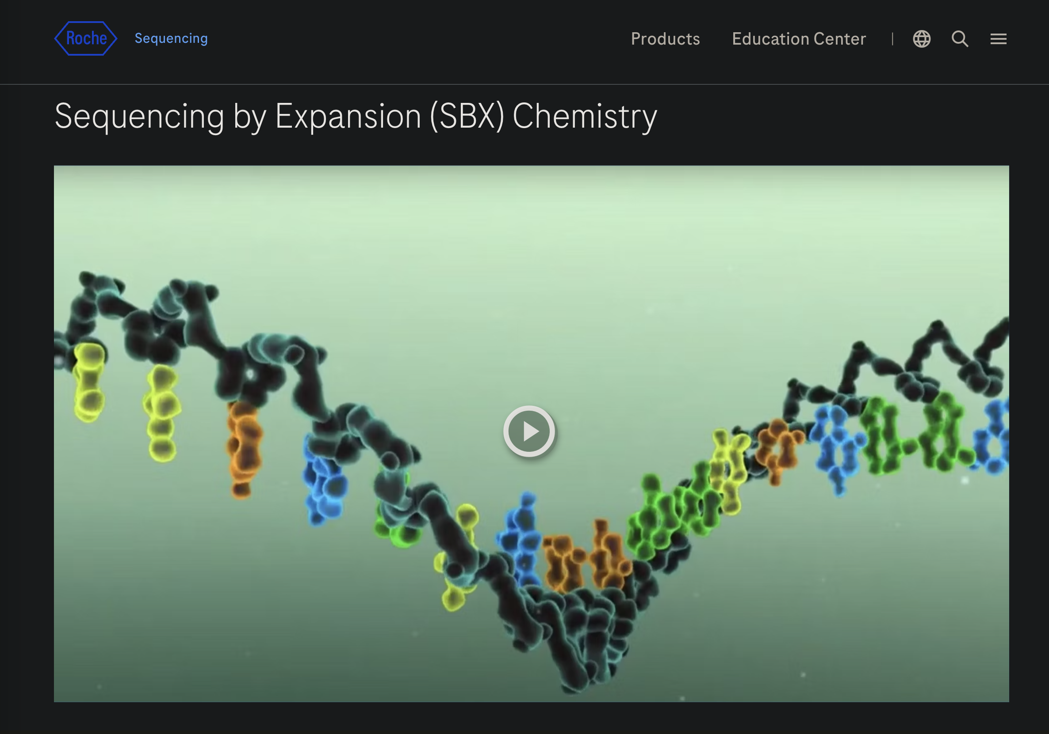
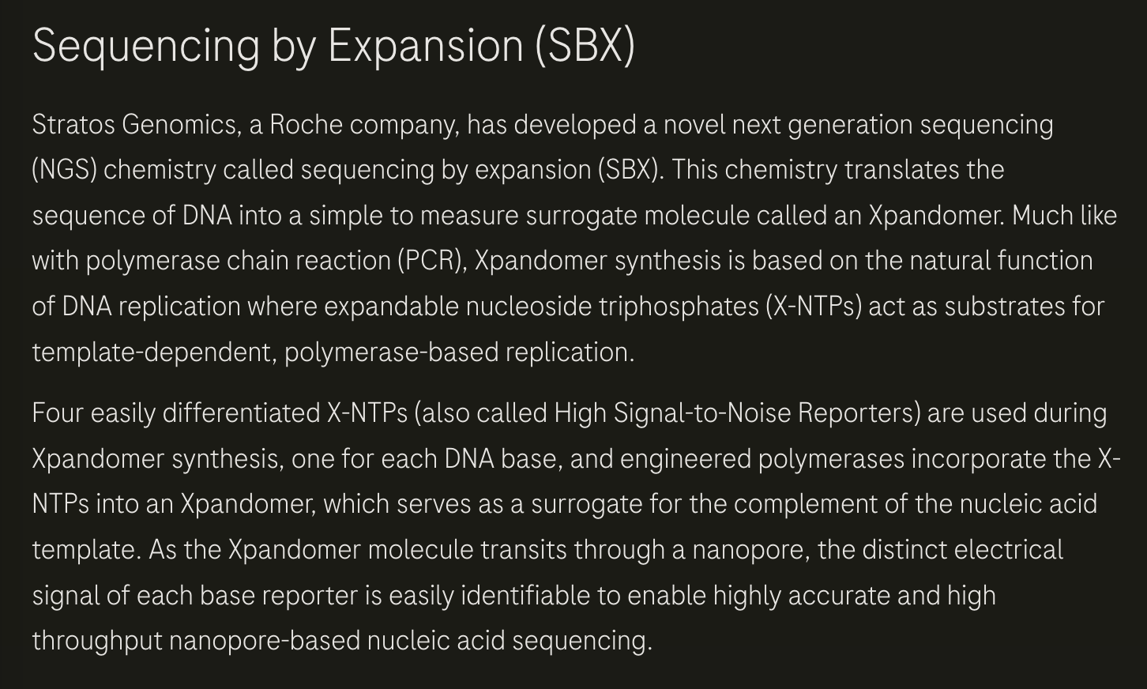
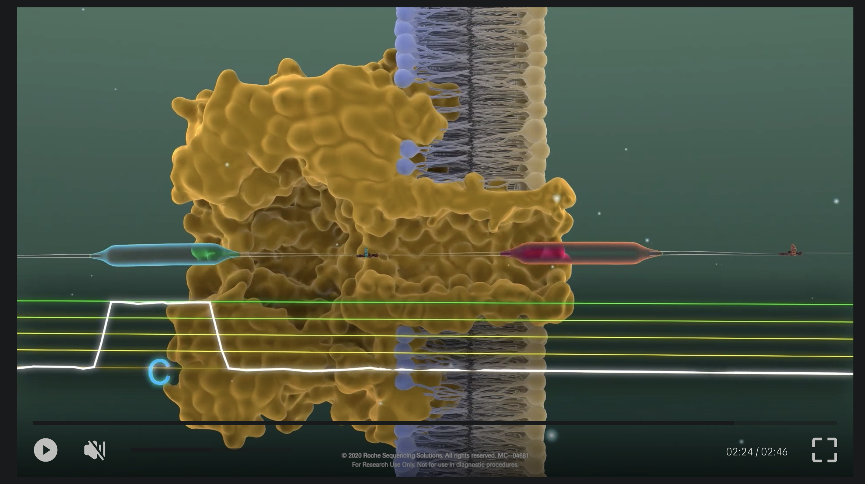
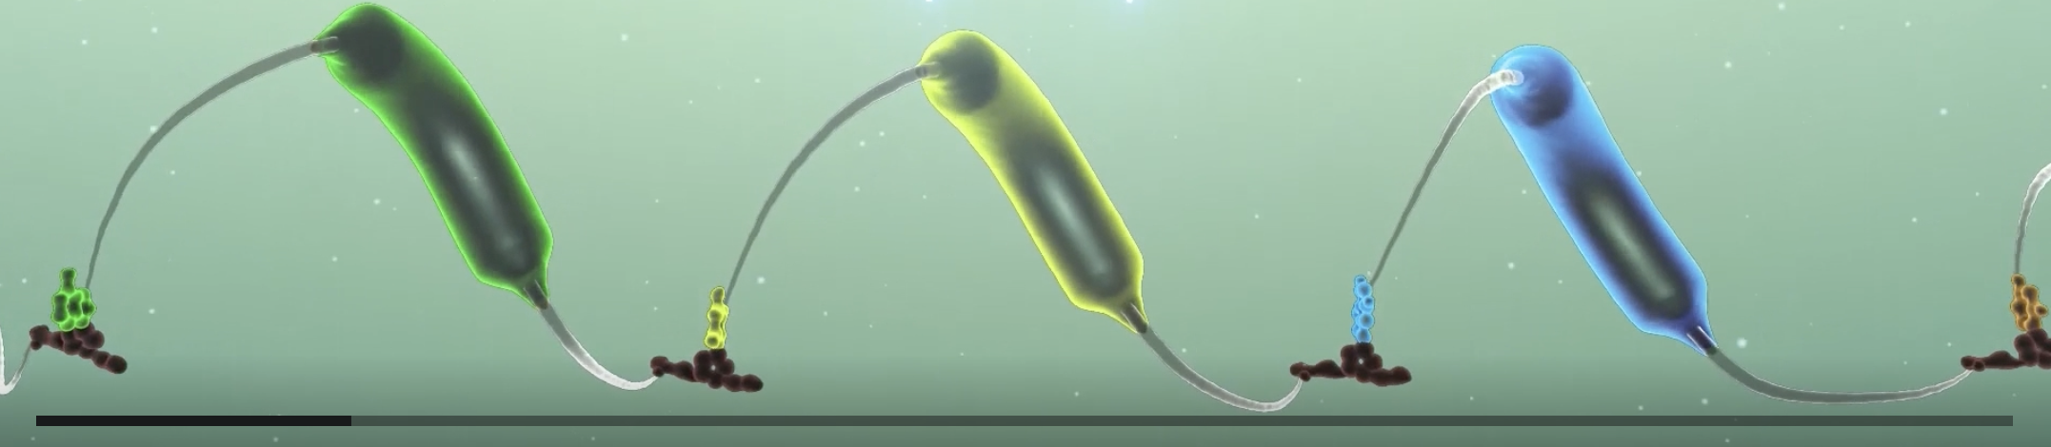
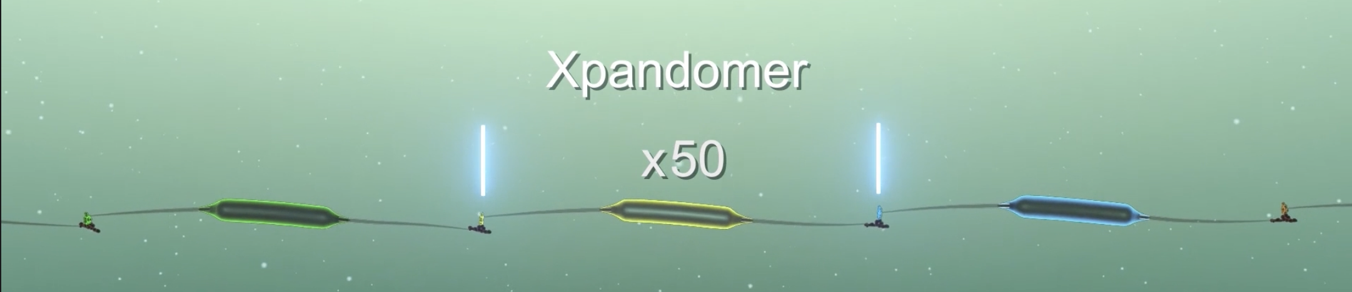
On the horizon: Roche SBX
(unveiled Feb, 2025 at AGBT)
https://sequencing.roche.com/global/en/article-listing/sequencing-platform-technologies.html

Slide 8
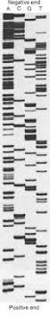
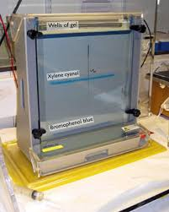
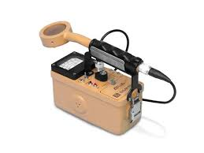
Personal Reflections...
Circa 1995

Slide 9
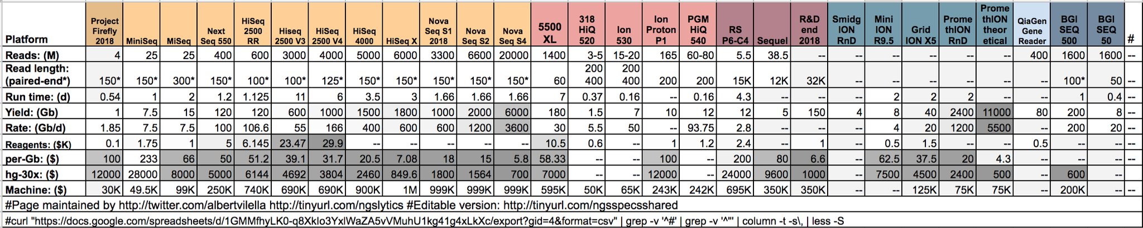
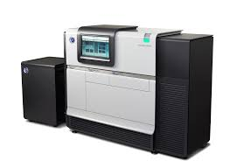
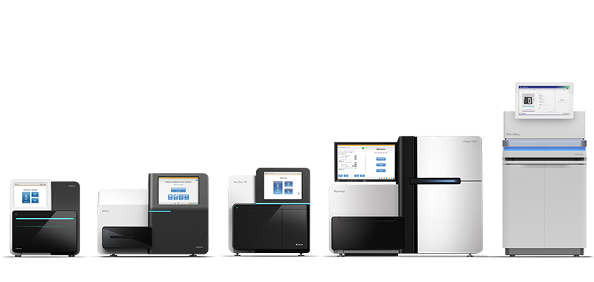
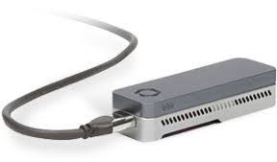
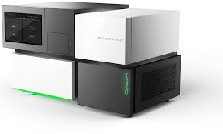
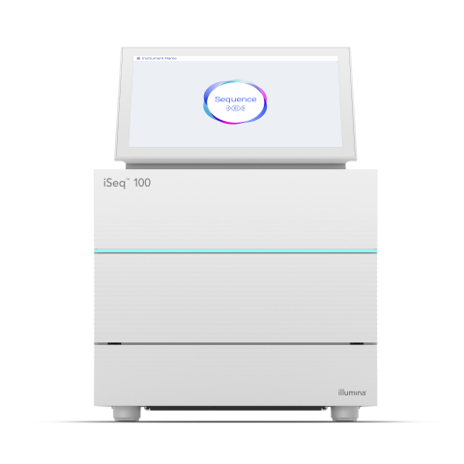
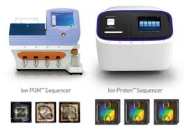
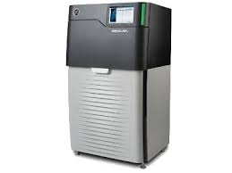
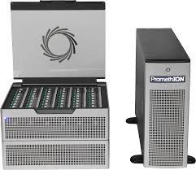
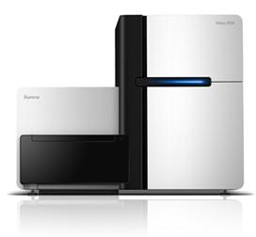
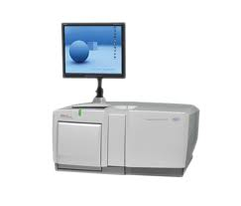
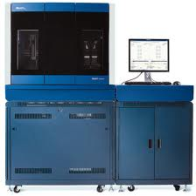
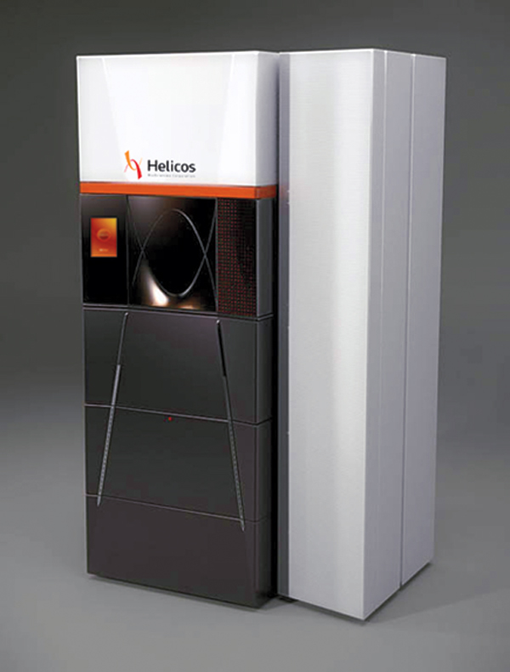
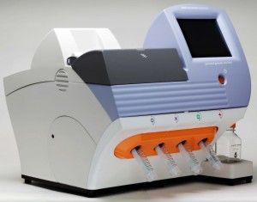
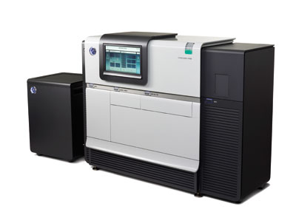
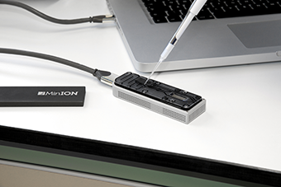
Generating RNA-Seq: How to Choose?
iSeq
Stats circa 2018
Note, stats may be outdated but demonstrates diversity and considerations
From: https://tinyurl.com/wbgcs65
*Not all shown at scale
$?
Read length?
Base accuracy?
Paired or single-end reads?
Single molecule?
Illumina
454
SOLiD
Helicos
Ion Torrent
Pacific Biosciences
Oxford Nanopore
Slide courtesy of Joshua Levin, Broad Institute.
Notes:
The current technological landscape for sequences is somewhat diverse, although there are some clear favorites and those that are currently dominating the market.
Illumina, in particular, is one of the dominating technologies.
This here is a table that contrasts the features of the different sequencers including cost, throughput, runtimes, read lengths, etc.
Prices vary considerably according to these specs, anywhere from tens of thousands to a million dollars, and that doesn’t cover the reagent costs. Julian covered many of these last week.

Slide 10
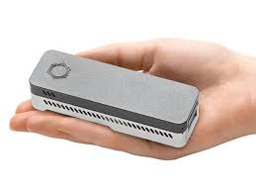
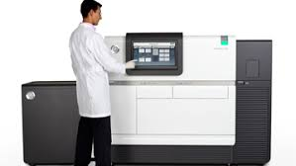
Each has pros/cons
The OG PacBio Sequencer
(way smaller now)

Slide 11
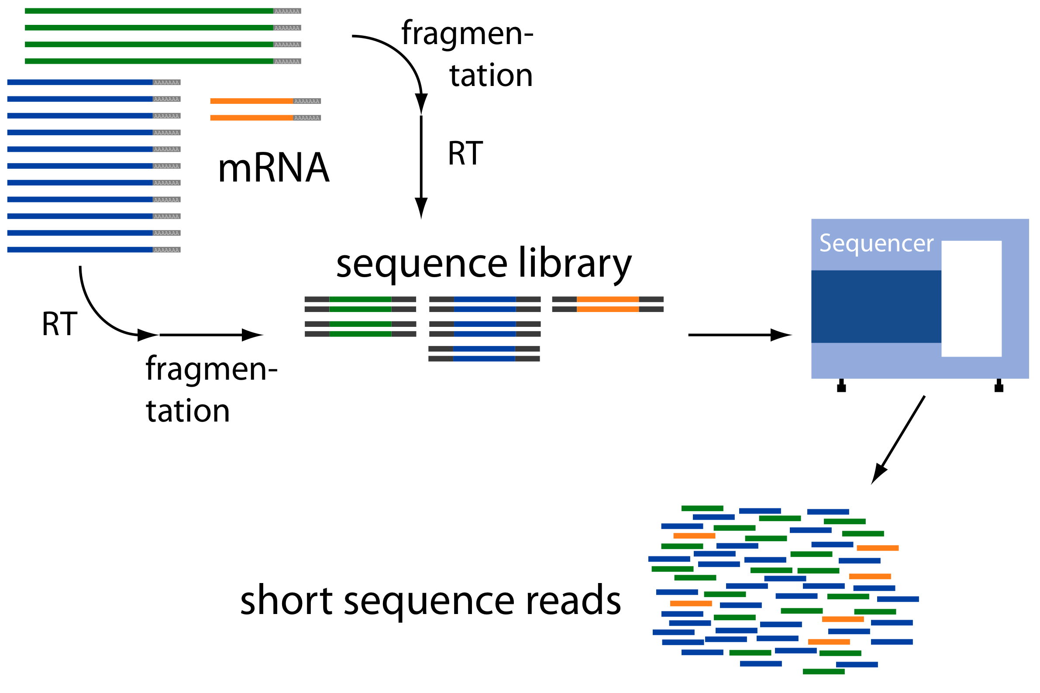
Overview of RNA-Seq
From: http://www2.fml.tuebingen.mpg.de/raetsch/members/research/transcriptomics.html

Slide 12
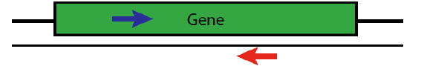
Paired-end Sequences
Two FastQ files, read name indicates left (/1) or right (/2) read of paired-end
@61DFRAAXX100204:1:100:10494:3070/1
AAACAACAGGGCACATTGTCACTCTTGTATTTGAAAAACACTTTCCGGCCAT
+
ACCCCCCCCCCCCCCCCCCCCCCCCCCCCCBC?CCCCCCCCC@@CACCCCCA
@61DFRAAXX100204:1:100:10494:3070/2
CTCAAATGGTTAATTCTCAGGCTGCAAATATTCGTTCAGGATGGAAGAACA
+
C<CCCCCCCACCCCCCCCCCCCCCCCCCCCCCCCCCCCCCCCCCCCCCBCCCC

Slide 13
RNA-Seq Challenge: Transcript Reconstruction
(Avg. ~ 2 kb)
(Avg. ~ 300 b)
Reconstruct original full-length transcripts
(~ 75 to 150 b reads, SE or PE)
Adapted from: http://www2.fml.tuebingen.mpg.de/raetsch/members/research/transcriptomics.html
Notes:
In any case, the transcriptome reads that are generated from sequencing are often much shorter than the original transcript molecules they were derived from, and one of the key bioinformatic challenges is to reconstruct the original full length transcript from the shorter sequencing reads.

Slide 14
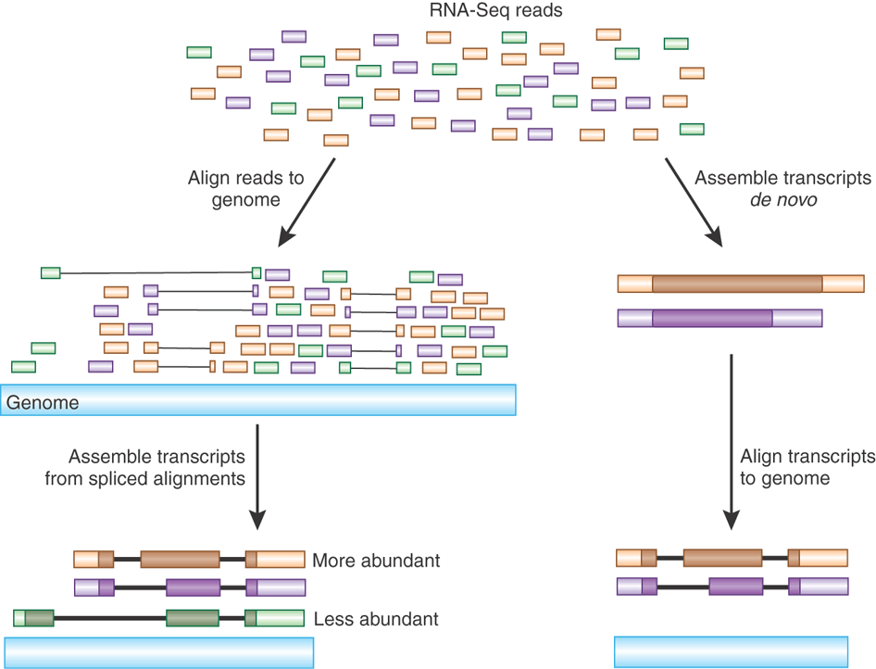
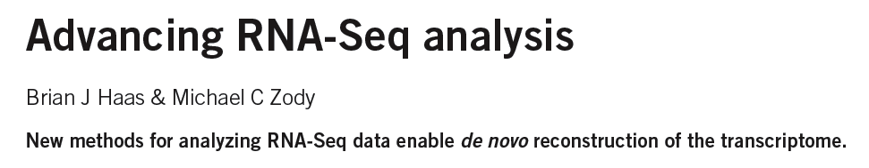
Transcript Reconstruction from RNA-Seq Reads
Nature Biotech, 2010
Notes:
One of the primary goals in RNA-Seq studies is to reconstruct the transcripts from which the short reads were derived, and transcript reconstruction is often a prerequisite to downstream studies such as genome annotation or diifferential expression analysis.
Two general strategies have been explored for reconstructing transcripts from RNA-Seq reads.

Slide 15
Transcript Reconstruction from RNA-Seq Reads
STAR
Notes:
One strategy requires having a reference genome and involves first aligning reads to the genome using a spliced aligner.

Slide 16
Transcript Reconstruction from RNA-Seq Reads
STAR
StringTie
Notes:
Then, the alignments, instead of the original reads, are assembled into transcript structures.

Slide 17
Transcript Reconstruction from RNA-Seq Reads
Non-model organisms:
“I don’t have a reference genome!”
Notes:
Then, if a genome sequence is available, the assembled transcripts can be aligned to the genome to reveal individual introns and exons.

Slide 18
Transcript Reconstruction from RNA-Seq Reads
TopHat
Trinity
Cufflinks
Notes:
An alternative strategy doesn’t require a reference genome and involves assembling the read sequences directly.

Slide 19
Transcript Reconstruction from RNA-Seq Reads
TopHat
Trinity
Cufflinks
minimap2
Notes:
Then, if a genome sequence is available, the assembled transcripts can be aligned to the genome to reveal individual introns and exons.

Slide 20

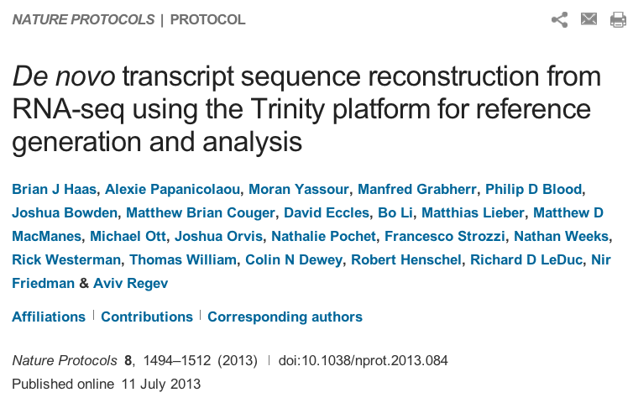
Transcript Reconstruction from RNA-Seq Reads
End-to-end Transcriptome-based RNA-Seq Analysis Software Package
Trinity
GMAP
minimap2
Notes:
Trinity is a software tool that I helped develop, and which we published last year in Nature Biotechnology.
In this talk, I’ll describe how Trinity works, and describe some of the applications that we aim to support.

Slide 21
Transcript Reconstruction from RNA-Seq Reads
Many tools to choose among:
Trinity
Oases
SoapDenovoTrans
AbyssTrans
IDBA-Tran
Shannon
BinPacker
Bridger
…
TopHat STAR HISAT
GSNAP
…
minimap2
GMAP
BLAT
AAT
Spidey
Sim4
…
Cufflinks
StringTie
IsoLasso
Bayesembler
Trip
Traph
CEM
TransComb
…
Notes:
Since the advent of RNA-Seq about a decade ago, there has been great progress in the development of bioinformatics tools for performing all of these operations, supporting both genome-guided and genome-free transcriptome reconstruction and analysis.
In the next series of slides, I’ll describe the basic computational algorithms used for transcript reconstruction.

Slide 22
Graph Data Structures Commonly Used For Assembly
Sequence
Order
Orientation (+, -)
Overlap
Reads to Graph
GTC
AGTCA
GATC
CG
GATTACA
CGATCA
AGC
Nodes = sequence (+/-)
Edges = order, overlap
Notes:
Both the genome-guided and genome-free transcript reconstruction approaches share some common algorithmic techniques.
----
A general features of these algorithms is to encode read sequences, read order, orientation, and overlap information
---
into a directed graph structure, with oriented sequences represented by nodes, and directed edges indicating overlap and orientation.

Slide 23
Graph Data Structures Commonly Used For Assembly
Sequence
Order
Orientation (+, -)
Overlap
Reads to Graph
GTC
AGTCA
GATC
CG
GATTACA
CGATCA
AGC
GATCGTCCGAGCGATTACA
Nodes = sequence (+/-)
Edges = order, overlap
Notes:
Full length transcripts are then reconstructed by traversing a directed path in the graph, guided by characteristics of the original reads including mate-pair constraints.
If there are multiple well-supported paths through this graph, then this would be considered evidence for alternative splicing.

Slide 24
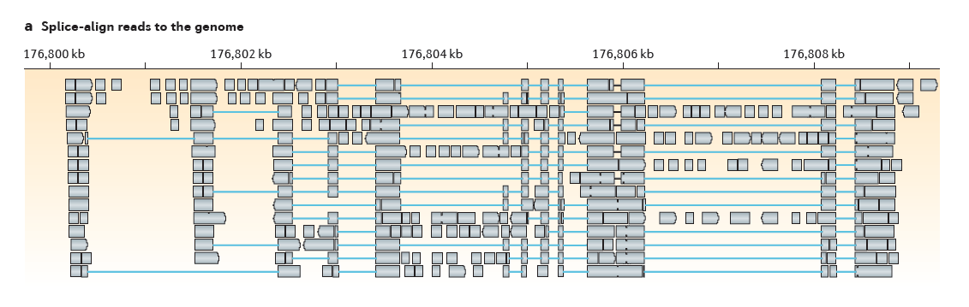
Genome-Guided Transcript Reconstruction
Splice-align reads to the genome
From Martin & Wang. Nature Reviews in Genetics. 2011
Notes:
In the case of genome-guided transcript reconstruction, the reads are aligned to the genome instead of being aligning to each other, and so we don’t encounter this scalability problem.
Here, the genome provides a scaffold by which the reads are ordered, oriented, and their overlaps are readily defined according to genomic location.
Here’s an example of a region of the genome where RNA-Seq reads were aligned…

Slide 25
Genome-Guided Transcript Reconstruction
Splice-align reads to the genome
Alignment segment piles => exon regions
From Martin & Wang. Nature Reviews in Genetics. 2011
Notes:
and we see stacks of reads piling up at locations throughout this locus.
The piles of alignment segments provide evidence of exons

Slide 26
Genome-Guided Transcript Reconstruction
Splice-align reads to the genome
Large alignment gaps => introns
From Martin & Wang. Nature Reviews in Genetics. 2011
Notes:
And the large gaps between alignment segments provide evidence of introns that were spliced out in the mature transcript.

Slide 27
Genome-Guided Transcript Reconstruction
Splice-align reads to the genome
Overlapping but different introns = evidence of alternative splicing
From Martin & Wang. Nature Reviews in Genetics. 2011
Notes:
In some cases, candidate introns are found to overlap but have different end points, and this provides evidence of alternative splicing.

Slide 28
Genome-Guided Transcript Reconstruction
Splice-align reads to the genome
From Martin & Wang. Nature Reviews in Genetics. 2011
Notes:
As discussed earlier, in order to assemble transcripts we’re going to encode the RNA-Seq data into a directed graph.
Based on the RNA-Seq read alignments, we were able to identify the individual exon and intron components of the gene expressed at this locus.

Slide 29
Genome-Guided Transcript Reconstruction
Splice-align reads to the genome
Individual reads can yield multiple exon and intron segments (splice patterns)
From Martin & Wang. Nature Reviews in Genetics. 2011
Notes:
If we look carefully, we can find examples of individual reads aligning to the genome and providing evidence for multiple introns and exons, and so we know that those introns and exons should be connected in the final transcript reconstructions.

Slide 30

Genome-Guided Transcript Reconstruction
Splice-align reads to the genome
Nodes = unique splice patterns
From Martin & Wang. Nature Reviews in Genetics. 2011
Notes:
We can identify all such unique splice patterns provided by the reads, and start building our graph using the splice patterns as nodes.

Slide 31
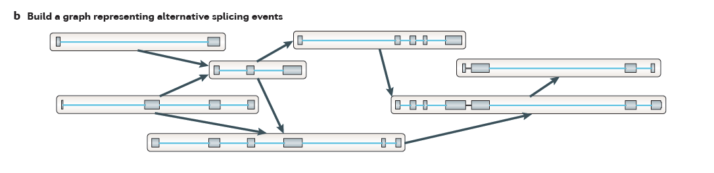
Genome-Guided Transcript Reconstruction
Splice-align reads to the genome
Construct graph from unique splice patterns of aligned reads.
Nodes = unique splice patterns
From Martin & Wang. Nature Reviews in Genetics. 2011
Notes:
We do this for all unique splice patterns. Here, the number of splice patterns is just a small fraction of the total number of aligned reads, and so we have a relatively few number of nodes to work with in our graph.

Slide 32
Genome-Guided Transcript Reconstruction
Splice-align reads to the genome
Construct graph from unique splice patterns of aligned reads.
Nodes = unique splice patterns
Edges = compatible patterns
From Martin & Wang. Nature Reviews in Genetics. 2011
Notes:
We then incorporate edges into the graph, drawing an edge between splice patterns that overlap and are compatible, that is to say that they could have come from the same transcript isoform. These are all cases where the splice patterns overlap and if there are introns in the overlapping region, those introns have identical splice sites.
For example, these top two alignment patterns overlap and they don’t conflict in their region of overlap. They could have come from the same transcript isoform, and so we can draw an edge between them.
----
Similarly, this splicing pattern demonstrates overlap, and the overlapping introns have identical splice sites, so these are deemed compatible, possibly deriving from the same transcript isoform, and we draw an edge between them.
----
We do this for all overlapping splice patterns.

Slide 33
Genome-Guided Transcript Reconstruction
Splice-align reads to the genome
Construct graph from unique splice patterns of aligned reads.
Nodes = unique splice patterns
Edges = compatible patterns
From Martin & Wang. Nature Reviews in Genetics. 2011
Notes:
Here we have those splice patterns that overlap but have different introns, and these could not have come from the same transcript, so we cannot draw an edge between them in our graph.

Slide 34
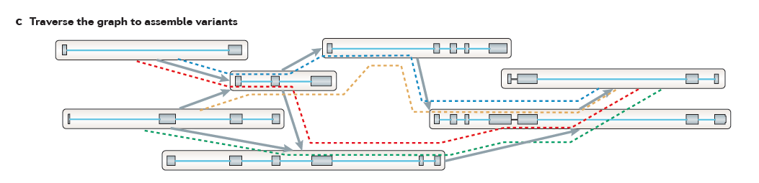
Genome-Guided Transcript Reconstruction
Traverse paths through the graph to assemble transcript isoforms
From Martin & Wang. Nature Reviews in Genetics. 2011
Notes:
Once we’ve completed our graph, we can then traverse paths through the graph to reconstruct candidate isoforms.
Here, we’ve outlined 4 possible paths…

Slide 35
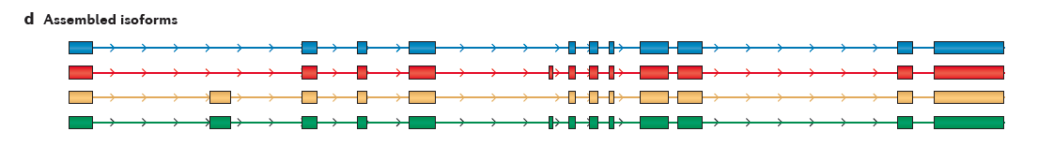
Genome-Guided Transcript Reconstruction
Traverse paths through the graph to assemble transcript isoforms
Reconstructed isoforms
From Martin & Wang. Nature Reviews in Genetics. 2011
Notes:
And tracing each path yields a different transcript structure.
There are a large number of variations of this technique, and it usually involves scoring the possible paths according to some objective function, and only reporting those candidate isoform reconstructions that are best supported by the read alignments.

Slide 36
What if you don’t have a high quality reference genome sequence?

Slide 37
Read Overlap Graph: Reads as nodes, overlaps as edges
Notes:
One way to build such a graph is treat each read as a separate node, and to perform all combinations of pairwise alignments between reads in order to identify overlaps and extensions.

Slide 38
Read Overlap Graph: Reads as nodes, overlaps as edges
Node = read
Edge = overlap
Notes:
From the overlap information, we would build an overlap graph with reads as nodes and overlaps as edges.

Slide 39
Read Overlap Graph: Reads as nodes, overlaps as edges
Transcript A
Generate consensus sequence where reads overlap
Node = read
Edge = overlap
Transcript B
Notes:
One could then trace the path of overlap extensions to assemble the longer sequence
----
If there are minor sequence differences in the regions of overlap that are likely due to sequencing error, these could be corrected by just taking a consensus and taking any original read quality information into account.

Slide 40

Finding pairwise overlaps between n reads involves ~ n² comparisons.
Impractical for typical RNA-Seq data (50M reads)
Notes:
This approach can be highly effective, but it simply doesn’t scale well for large data sets such as those generated using RNA-Seq.
Building the overlap graph involved aligning and comparing each read to every other read. If we have ‘n’ reads, then this would involve roughly n^2 number of comparisons.
----
If we plot the number of pairwise alignments required as a function of the number of reads, we see that the number of alignments grows exponentially.
----
This is a problem because it means that the amount of time it would take to do the alignments as well as the amount of computer hardware required to store the information would also grow exponentially, and so it’s just not a viable approach for assembling the many millions or billions of reads generated in an RNA-Seq experiment.

Slide 41
No genome to align to… De novo assembly required
Want to avoid n² read alignments to define overlaps
Use a de Bruijn graph
Notes:
If we don’t have a genome to align to, we need to be able to assemble the reads directly, but we need a way to avoid doing all pairwise alignments between the reads.
----
A popular technique for doing de novo assembly of short reads is to leverage a de Bruijn graph data structure. The de Bruijn graph was initially applied to genome assembly and was later adopted for transcriptome assembly. There are some key differences between assembling genomes and assembling transcriptomes using de Bruijn graphs, and I’ll comment more on that shortly.

Slide 42

Sequence Assembly via de Bruijn Graphs
Generate all substrings of length k from the reads
k-mers (k=5)
Reads
From Martin & Wang, Nat. Rev. Genet. 2011
Notes:
A de Bruijn graph represents connectivity between sequences observed within reads, and the overlaps between reads are apparent by the virtue of having shared substrings.
The first step in a de Bruijn graph-based assembly is to construct the de Bruijn graph from the sequence reads.
Each read is decomposed into substrings of some specified length k. Each word of length k is called a k-mer. In this example, k is set to 5, so here each 5-mer is extracted from the read.
----
An ordered list of k-mers is generated by scanning a window of length k across the length of the read.

Slide 43
Sequence Assembly via De Bruijn Graphs
Generate all substrings of length k from the reads
k-mers (k=5)
Reads
From Martin & Wang, Nat. Rev. Genet. 2011
Notes:
That kmer is extracted from the read sequence

Slide 44

Sequence Assembly via De Bruijn Graphs
Generate all substrings of length k from the reads
k-mers (k=5)
Reads
Construct the de Bruijn graph
Nodes = unique k-mers
From Martin & Wang, Nat. Rev. Genet. 2011
Notes:
and inserted as a node in our de Bruijn graph. This graph node now represents this unique kmer sequence, and this single node will represent this unique kmer for every occurrence of this kmer in the entire set of reads.

Slide 45
Sequence Assembly via De Bruijn Graphs
Generate all substrings of length k from the reads
k-mers (k=5)
Reads
Construct the de Bruijn graph
Nodes = unique k-mers
Edges = overlap by (k-1)
From Martin & Wang, Nat. Rev. Genet. 2011
Notes:
We then shift the window over by one base, extract that k-mer…

Slide 46
Sequence Assembly via De Bruijn Graphs
Generate all substrings of length k from the reads
k-mers (k=5)
(k-1) overlap
Reads
Construct the de Bruijn graph
Nodes = unique k-mers
Edges = overlap by (k-1)
From Martin & Wang, Nat. Rev. Genet. 2011
Notes:
and insert it as another node in our de Bruijn graph.

Slide 47
Sequence Assembly via De Bruijn Graphs
Generate all substrings of length k from the reads
k-mers (k=5)
(k-1) overlap
Reads
Construct the de Bruijn graph
Nodes = unique k-mers
Edges = overlap by (k-1)
From Martin & Wang, Nat. Rev. Genet. 2011
Notes:
For each pair of neighboring k-mers, which overlap by k-1 bases, we include an edge between them in the graph.

Slide 48
Sequence Assembly via De Bruijn Graphs
Generate all substrings of length k from the reads
k-mers (k=5)
Reads
Construct the de Bruijn graph
Nodes = unique k-mers
Edges = overlap by (k-1)
From Martin & Wang, Nat. Rev. Genet. 2011
Notes:
We continue to do this for all reads and fully construct our de Bruijn graph.
This de Bruijn graph is a very effective and compact way of representing the sequence data within the reads. For example, hundreds of millions of reads can be sequenced, and the identical sequence regions within reads become compressed into individual nodes within the graph.
At positions where related sequences diverge due to allelic polymorphisms, splicing variations, repeats, or due to sequencing errors, the graph will branch and can form bulges or loops.

Slide 49

Construct the de Bruijn graph
Collapse the de Bruijn graph
From Martin & Wang, Nat. Rev. Genet. 2011
Notes:
After building the graph from all the reads, the graph is typically pruned to remove bubbles and structures that likely stem from sequencing errors,
and the graph is further simplified by collapsing those nodes that form linear unbranched chains of overlapping k-mers.
--
For example, this linear chain of kmers is compressed into a single node in the compacted graph.

Slide 50


Collapse the de Bruijn graph
Traverse the graph
Assemble Transcript Isoforms
From Martin & Wang, Nat. Rev. Genet. 2011
Notes:
Now, to reconstruct transcripts, we define paths in the graph that are supported by the reads, and traverse those paths to reconstruct complete isoform sequences.
--
In this example, there are again four possible paths from the beginning to the end of the graph, each path shown traced by a different color.
By traversing each path, a different transcript sequence is generated.
--
Again, there are many different algorithms and techniques for defining best paths within this graph, and ideally the best paths reported are those that are best supported by the RNA-Seq data, taking into account the paths supported by individual read sequences and any mate-pairing information that may be available.

Slide 51

Contrasting Genome and Transcriptome De novo Assembly
Genome Assembly
Transcriptome Assembly
Uniform coverage
Exponentially distributed coverage levels
Single contig per locus
Multiple contigs per locus (alt splicing)
Assemble small numbers of large Mb-length chromosomes
Assemble many thousands of Kb-length transcripts
Double-stranded data
Strand-specific data available
Notes:
Both genome and transcriptome assemblers make use of de Bruijn graphs for assembly, but they are tuned to assemble reads according to very different expected characteristics. This is why you wouldn’t want to leverage a genome assembler for transcriptome assembly and vice-versa, since each method is highly specialized.
Some of the key differences between what’s expected by genome and transcriptome assemblers include the following:
--
Genome assemblers expect that read coverage is going to be rather uniform and will often discard sequences that occur at high coverage as repetitive sequences. In contrast, transcriptome assembly needs to consider a wide range of coverage levels spanning several orders of magnitude since sequences with high coverage are more likely to represent highly expressed transcripts instead of repeats.
--
Genome assemblers typically aim to generate a single contig per locus. In transcriptome assembly, it’s understood that single genes can generate many alternatively spliced transcripts, and multiple contigs are reported per locus where evidence of transcript complexity exists.
--
Genome assemblers aim to produce small numbers of very long contig, ideally reconstructing entire megabase-sized chromosomes where possible. Transcriptome assemblers are generally tasked with assembling many thousands of separate transcripts, on the order of thousands of bases in length.
--
Finally, in genome assembly, reads are assumed to be derived from either strand of the double-stranded DNA molecule. Conventional RNA-Seq offers the option of generating strand-specific data, and Transcriptome assemblers need to consider strand-specific data in order to assemble sense and antisense transcripts separately.

Slide 52




Trinity – How it works:
RNA-Seq reads
Linear
contigs
de-Bruijn
graphs
Transcripts
+
Isoforms
Thousands of disjoint graphs
Notes:
Here’s a high-level overview of the whole Trinity assembly algorithm.
We call it Trinity because it involves three major steps that we’ve built into three separate software modules.
It starts with Inchworm, which first assembles the RNA-Seq data into linear contigs.
Then, Chrysalis groups contigs that are related due to alternative splicing or gene duplication and constructs de bruijn graphs.
Finally, Butterfly examines reads in the context of the de bruijn graphs, and reports the final full-length transcripts and isoforms of transcripts.

Slide 53
Inchworm Algorithm
Decompose all reads into overlapping Kmers => hashtable(kmer, count)
Read:
AATGTGAAAACTGGATTACATGCTGGTATGTC…
AATGTGA
ATGTGAA
Overlapping kmers of length (k)
TGTGAAA
…
Kmer Catalog (hashtable)
Kmer | Count among all reads
AATGTGA | 4
ATGTGAA | 2
TGTGAAA | 1
GATTACA | 9
Notes:
The inchworm algorithm is quite simple.
It first decomposes reads into a catalog of overlapping Kmers,
----
and builds a hashtable containing the kmers and the count of the number of times that kmer is found in all the reads.

Slide 54
Inchworm Algorithm
Decompose all reads into overlapping Kmers => hashtable(kmer, count)
Identify seed kmer as most abundant Kmer, ignoring low-complexity kmers.
GATTACA
9
Kmer Catalog (hashtable)
Kmer | Count among all reads
AATGTGA | 4
ATGTGAA | 2
TGTGAAA | 1
GATTACA | 9
https://en.wikipedia.org/wiki/Gattaca
Notes:
The single most abundant kmer with reasonable sequence complexity is identified as a seed kmer.
Ethan Hawke in GATTACA

Slide 55
Inchworm Algorithm
Decompose all reads into overlapping Kmers => hashtable(kmer, count)
Identify seed kmer as most abundant Kmer, ignoring low-complexity kmers.
Extend kmer at 3’ end, guided by coverage.
G
A
GATTACA
9
T
C
Notes:
This seed kmer is then extended at the 3’ end guided by the coverage of overlapping kmers.
For each extension, there are four possible kmers, each ending with one of the four possible nucleotides.

Slide 56
Inchworm Algorithm
G
4
A
GATTACA
9
T
C
Notes:
Each of the possible overlapping kmers is looked up in the kmer catalog to determine their frequency within the reads.
In this toy example, the kmer ending with ‘G’ is found 4 times.

Slide 57
Inchworm Algorithm
G
4
A
GATTACA
1
9
T
C
Notes:
‘A’ is found once.

Slide 58
Inchworm Algorithm
G
4
A
GATTACA
1
9
T
0
C
Notes:
The kmer ending with ‘T’ doesn’t exist in the reads, so it has a count of zero.

Slide 59
Inchworm Algorithm
G
4
A
GATTACA
1
9
T
0
C
4
Notes:
And the kmer ending with ‘C’ is found 4 times.

Slide 60
Inchworm Algorithm
G
4
A
GATTACA
1
9
T
0
C
4
Notes:
In this case we have a tie.

Slide 61
Inchworm Algorithm
G
A
0
5
T
1
G
4
C
A
0
GATTACA
1
9
T
0
G
C
1
4
A
1
C
T
1
1
Notes:
When we encounter a tie, we explore the tied paths recursively to find that extension that provides the highest cumulative coverage.

Slide 62
Inchworm Algorithm
G
A
0
5
T
1
G
4
C
A
0
GATTACA
1
9
T
0
G
C
1
4
A
1
C
T
1
1
Notes:
In this case, the extension of two overlapping kmers ending with an ‘A’ provides the highest cumulative coverage, and so the other paths are ignored.

Slide 63
Inchworm Algorithm
A
5
G
4
GATTACA
9
Notes:
Extensions continue to occur in this way until there are no more kmers that provide for an extension.

Slide 64
Inchworm Algorithm
A
5
C
G
0
4
T
0
GATTACA
A
9
6
G
1
Notes:
Then, we extend from right to left in the same manner, following the path of greatest coverage.

Slide 65
Inchworm Algorithm
A
5
G
4
GATTACA
A
9
6
A
7
Report contig: ….AAGATTACAGA….
Remove assembled kmers from catalog, then repeat the entire process.
Notes:
Once the extension completes, the assembled contig is reported.
--transition—
The kmers found in the contig are removed from the kmer catalog, and the entire process is repeated starting from a new seed. The Inchworm assembly ends when the entire k-mer catalog has been depleted.

Slide 66



Chrysalis
Integrate isoforms
via k-1 overlaps
Build de Bruijn Graphs
(ideally, one per gene)
Notes:
Here is a high-level overview of the Chrysalis operations.
Chrysalis clusters related contigs based on these k-1mer overlaps.
Chyrsalis also leverages read pairing information to join minimally overlapping contigs.
--
After identifying the connected inchworm contigs, it constructs a separate de Bruijn graph for each group.
(Again, the de Bruijn graph represents the overlaps between adjacent kmers in the sequences with branches at sites of variation.)

Slide 67
Thousands of Chrysalis Clusters
Notes:
And this is how we end up with many separate graphs, ideally one graph per gene, with each graph representing the transcriptional complexity at that locus.
These graphs can then be processed in a parallel fashion by the next step of Trinity involving Butterfly.

Slide 68

(isoforms and paralogs)
Notes:
Butterfly operates on each of these graphs independently.
It first compacts the de Bruijn graph by collapsing the unbranched stretches, as described earlier.
It then threads the original sequencing reads into the graph, tracking the paths occupied by the reads and those paths supported by mate pairs.
Butterfly then reports the most probable paths through the graph supported by the reads and read pairings, emitting full-length transcripts for isoforms and paralogs.

Slide 69

Trinity output: A multi-fasta file

Slide 70



Notes:
Last year, we published a paper in Nature Protocols that outlines how you would perform a Trinity de novo assembly followed by supported downstream analyses including abundance estimation, differential expression analysis, and exploring patterns of transcript expression across multiple sample types.

Slide 71


Slide 72

ProgForBio Exercise : Build a program that counts k-mers
Generate all substrings of length k from the reads
k-mers (k=5)
Reads
https://github.com/trinityrnaseq/CSHLProgForBio/tree/main/Exercise-counting_kmers
Notes:
We continue to do this for all reads and fully construct our de Bruijn graph.
This de Bruijn graph is a very effective and compact way of representing the sequence data within the reads. For example, hundreds of millions of reads can be sequenced, and the identical sequence regions within reads become compressed into individual nodes within the graph.
At positions where related sequences diverge due to allelic polymorphisms, splicing variations, repeats, or due to sequencing errors, the graph will branch and can form bulges or loops.

Slide 73
Some Important Python Coding Conventions
PEP8 Summary from Google AI
Python coding conventions are outlined in PEP 8, the official style guide for Python code. Here's a summary of the key points:
Naming Conventions:
• Variables and Functions: Use lowercase with underscores for separation (e.g., my_variable, calculate_average).
• Constants: Use uppercase with underscores (e.g., MAX_VALUE, PI).
• Classes: Use CamelCase (e.g., MyClass, ShoppingCart).
• Modules: Use lowercase (e.g., mymodule, utils).
Whitespace:
• Indentation: Use 4 spaces per indentation level.
• Spaces: Use spaces around operators and after commas (e.g., x = 1 + 2).
• Blank Lines: Use blank lines to separate functions and classes, and within functions to separate logical blocks.
Line Length:
Keep lines under 79 characters.
Imports:
• Put imports at the top of the file.
• Group imports in this order: standard library, third-party libraries, and local modules.
Docstrings:
• Use docstrings to document modules, classes, functions, and methods.
Other Important Conventions:
• Avoid using global variables.
• Use meaningful variable names.
• Write clear, concise code.
• Test your code thoroughly.
https://peps.python.org/pep-0008/

Slide 74
A useful structure of a python script for shareable functions
(How B. Haas often does it)
#!/usr/bin/env python3
Import sys, os, re
def func_A(myvar):
…
…
return something
def func_B(myvar):
…
…
return something
def main():
# test func_A
…..
# test func_B
….
If __name__==‘__main__’:
main()
Import modules you need in this script
Function definitions
Driver
Driver only run if the script containing it is directly executed
( not when imported)

Slide 75
Build in 3 phases – demonstrating function reuse
retrieving the sequences from a fastq file fastq_file_to_sequence_list.py
B. extracting kmers from an individual sequence sequence_to_kmer_list.py
C. counting the kmers among all sequences count_kmers_from_fastq.py
Functions imported and reused

Slide 76

Useful structure of a python script for shareable functions
my_module.py
(can run directly or use as a function library)
executed
When a script is executed, the special __name__ variable is automatically set to ‘__main__’ within the scope of that file.
https://github.com/trinityrnaseq/CSHLProgForBio/tree/main/whatsupwith__name__%3F

Slide 77

Useful structure of a python script for shareable functions
my_module.py
(can run directly or use as a function library)
my_script.py
imported
executed
Uses imported decorate_name_val()
https://github.com/trinityrnaseq/CSHLProgForBio/tree/main/whatsupwith__name__%3F

Slide 78
Build in 3 phases – demonstrating function reuse
retrieving the sequences from a fastq file fastq_file_to_sequence_list.py
B. extracting kmers from an individual sequence sequence_to_kmer_list.py
C. counting the kmers among all sequences count_kmers_from_fastq.py
Functions imported and reused

Slide 79

GitHub link: https://github.com/trinityrnaseq/CSHLProgForBio/tree/main/Exercise-counting_kmers#part-a-retrieve-sequences-from-a-fastq-file

Slide 80


A. fastq_file_to_sequence_list.py
Reusable function part:
Driver part for testing:
https://github.com/trinityrnaseq/CSHLProgForBio/blob/main/Exercise-counting_kmers/fastq_file_to_sequence_list.py

Slide 81
Build in 3 phases – demonstrating function reuse
retrieving the sequences from a fastq file fastq_file_to_sequence_list.py
B. extracting kmers from an individual sequence sequence_to_kmer_list.py
C. counting the kmers among all sequences count_kmers_from_fastq.py
Functions imported and reused

Slide 82


Slide 83


B. sequence_to_kmer_list.py
Reusable function part
Driver part for testing:
https://github.com/trinityrnaseq/CSHLProgForBio/blob/main/Exercise-counting_kmers/sequence_to_kmer_list.py

Slide 84
Build in 3 phases – demonstrating function reuse
retrieving the sequences from a fastq file fastq_file_to_sequence_list.py
B. extracting kmers from an individual sequence sequence_to_kmer_list.py
C. counting the kmers among all sequences count_kmers_from_fastq.py
Functions imported and reused

Slide 85


Slide 86





C. count_kmers_from_fastq.py
Main code block
Import earlier functions
New function to implement
Step 1
Step 2
Step 3
https://github.com/trinityrnaseq/CSHLProgForBio/blob/main/Exercise-counting_kmers/count_kmers_from_fastq.py

Slide 87

Extra Credit

Slide 88

Higher entropy indicates greater sequence complexity or diversity, while lower entropy reflects bias or repetitiveness (e.g., homopolymers)

Slide 89


No use of coding help from artificial intelligence (AI) before dinner!!
After dinner, we’ll unleash the power of AI

